Slide 1
Relational Models

Slide 2
Relational Models
Relational data model is the primary data model, which is used widely around the world for data storage and processing.
This model is simple and it has all the properties and capabilities required to process data with storage efficiency.

Slide 3
Tables − In relational data model, relations are saved in the format of Tables. This format stores the relation among entities. A table has rows and columns, where rows represents records and columns represent the attributes.
Tuple − A single row of a table, which contains a single record for that relation is called a tuple.
Relation instance − A finite set of tuples in the relational database system represents relation instance. Relation instances do not have duplicate tuples.
Relation schema − A relation schema describes the relation name (table name), attributes, and their names.
Relation key − Each row has one or more attributes, known as relation key, which can identify the row in the relation (table) uniquely.

Slide 4
RELATION: A table of values
A relation may be thought of as a set of rows.
Each row represents a fact that corresponds to a real-world entity or relationship.
Each row has a value of an item or set of items that uniquely identifies that row in the table.
Each column typically is called by its column name or column header or attribute name

Slide 5
Formal definitions
The Schema (or description) of a Relation:
Denoted by R(A1, A2, .....An)
– R is the name of the relation
– The attributes of the relation are A1, A2, ..., An
Example:
CUSTOMER (Cust-id, Cust-name, Address, Phone#)
CUSTOMER is the relation name
Defined over the four attributes: Cust-id, Cust-name, Address,Phone#
Each attribute has a domain or a set of validvalues.
– For example, the domain of Cust-id is 6 digit numbers.

Slide 6
A row is called a tuple, which is an ordered set of values
A column header is called an attribute – Each attribute value is derived from an appropriate domain.
The table is called a relation. – A relation can be regarded as a set of tuples (rows).
The data type describing the types of values an attribute can have is represented by a domain of possible values.
Each row in the CUSTOMER table is a 4-tuple and consists of four values, for example.
A relation is a set of such tuples (rows).

Slide 7
Formal Query Languages
Relational Algebra

Slide 8
Introduction
Query → retrieval of information
Query language → language that is used for information retrieval
Formal query languages → based upon which SQL is developed
Types:
Relational Algebra
Tuple Relational Calculus
Domain Relational Calculus

Slide 9
Relational Algebra
Procedural query language
Consists of a set of operations that take one or two relations as input and produce a new relation as their output
Intermediate language used within DBMS . Procedural.
Structured Query Language(SQL) -Predominant application-level query language Declaration.

Slide 10
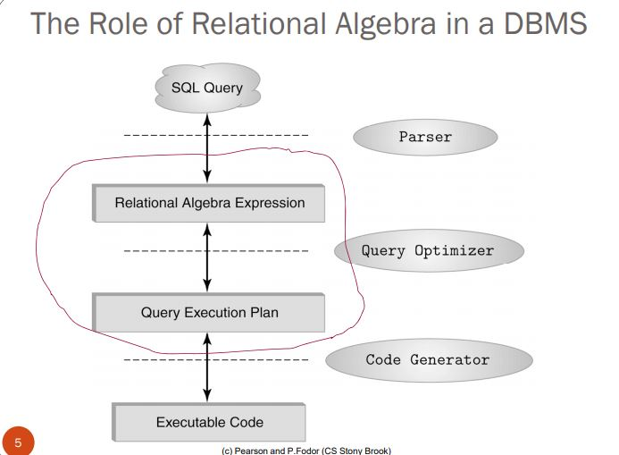

Slide 11
Fundamental Operations
Select
Project
Union
Set difference
Cartesian product
Rename
Note: select, project, rename – called as ‘unary’ operators and the remaining are ‘binary’ operators

Slide 12
Additional Operations
Set intersection
Natural join
Outer joins
Left outer join
Right outer join
Full outer join
Assignment

Slide 13
Select Operation
The select operation display tuples that satisfy a given predicate (condition).
We use the lowercase Greek letter sigma to denote selection.
It produces a “horizontal” subset.
Syntax: σ_{C}(R)
where C is a selection condition(=, <, >, =<, >=, <>)
and R is the relation over which the selection takes place

Slide 14
Example of Select
Student
sid name addr
123 Fred 3 Oxford
345 John 6 Hope Rd.
567 Ann 5 Garden
Find all students whose id is above 300.
Query: σ _{sid > 300}(Student)
Resulting Relation:
sid name addr
345 John 6 Hope Rd
567 Ann 5 Garden

Slide 15
Project Operation
The project operation display attributes that satisfy a given predicate (condition).
We use the lowercase Greek letter pi to denote selection.
It produces a “vertical” subset.
Eliminates duplicated values.
Syntax: П_{A}(R)
where A is a set of attributes of R
and R is the relation over which the project takes place

Slide 16
Example of Project
Enrollment
sid cid grade
123 CS51T 76
234 CS52S 50
345 CS52S 55
Display all course id values
Query: П_{cid}(Enrollment)
cid
CS51T
CS52S

Slide 17
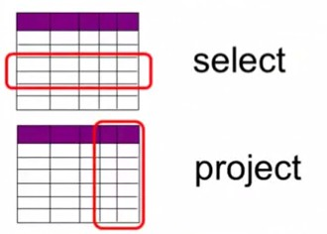

Slide 18
SELECTION & PROJECTION Example
Person
Id | Name | Address | Hobby
1123 | John | 123 Main | stamps
1123 | John | 123 Main | coins
5556 | Mary | 7 Lake Dr | hiking
9876 | Bart | 5 Pine St | stamps
∏Name, Hobby(Person)
Name | Hobby
John | stamps
John | coins
Mary | Hiking
Bart | stamps
σ Hobby=‘stamps’(Person)
Id | Name | Address | Hobby
1123 | John | 123 Main | stamps
9876 | Bart | 5 Pine St | stamps

Slide 19
Examples
σ _{Id>3000 OR Hobby=‘hiking’} (Person)
σ _{Id>3000 AND Id <3999} (Person)
σ _{NOT(Hobby=‘hiking’)} (Person)
σ _{Hobby≠‘hiking’} (Person)
π _{Id} (Person)
π _{Hobby} (Person)

Slide 20
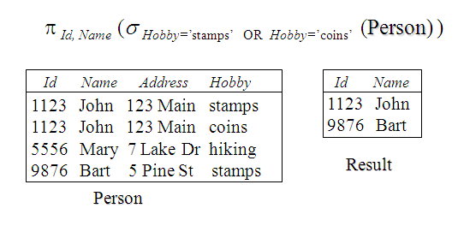
Relational Algebra Expressions

Slide 21
Union Operation
Creates a relation that contains all the values in both the relations.
Two relations are union compatible if:
Both have same number of columns
Names of attributes are the same in both
Represented using the symbol ‘∪’.
Eliminate duplicates
Syntax: S1 ∪ S2
where S1, S2 are separate relations

Slide 22
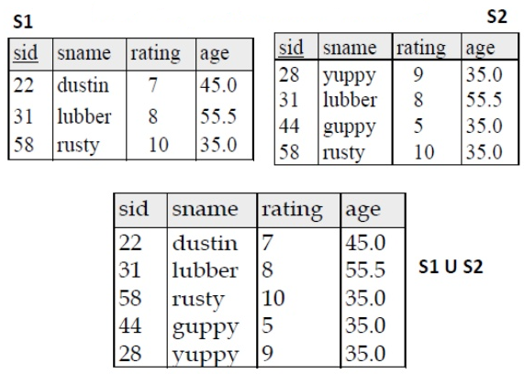
Example

Slide 23
The Set-Difference Operation
Allows us to find tuples that are in one relation but are not in another.
Denoted by the symbol ‘−’.
Syntax: S1 – S2
where S1, S2 are separate relations

Slide 24
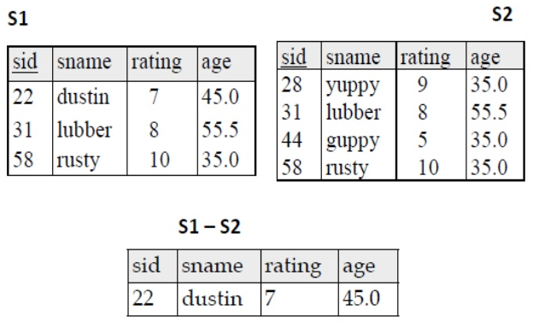
Example

Slide 25
Cartesian Product
The Cartesian product of two tables combines each row in one table with each row in the other table.
A relation is by definition a subset of a Cartesian product of a set of domains.
Denoted by the symbol ‘ X ‘.
Syntax: S1 X R1
where S1, R1 are separate relations

Slide 26
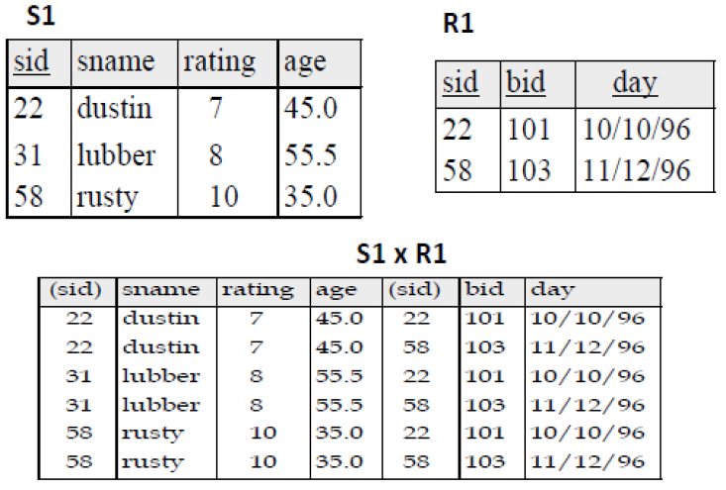
Example

Slide 27

Rename
The results of relational-algebra expressions do not have a name that we can use to refer to them.
It is useful to be able to give them names using the rename operator.
Denoted by the lowercase Greek letter rho ( )
Syntax:
where x is the new name for the relational algebra expression E.

Slide 28
ρ(Relation2, Relation1)
To rename STUDENT relation to STUDENT1, we can use rename operator like:
ρ(STUDENT1, STUDENT) If you want to create a relation STUDENT_NAMES with ROLL_NO and NAME from STUDENT, it can be done using rename operator as:
ρ(STUDENT_NAMES, ∏_{(ROLL_NO,} _{NAME)}(STUDENT))

Slide 29
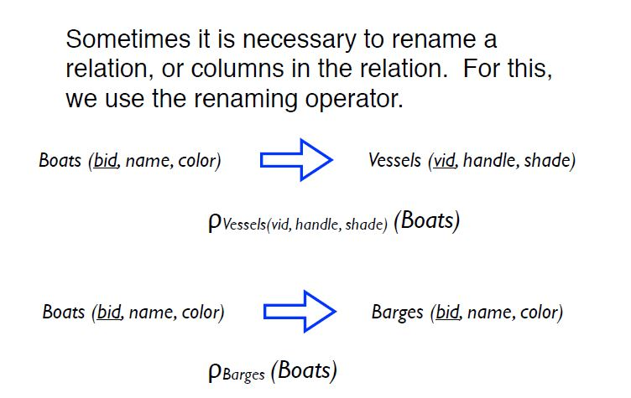

Slide 30
Assignment Operator
It is convenient at times to write a relational-algebra expression by assigning parts of it to temporary relation variables.
The assignment operation, denoted by ←, works like assignment in a programming language.
Example: r1 ← s1 X s2
Here s1 and s2 are two separate relations , whereas r1 is a temporary relation variable.

Slide 31
Set Intersection
Creates a relation by taking only the common values in both relations.
Represented using the symbol ‘∩ ’.
Syntax: S1 ∩ S2
where S1, S2 are separate relations

Slide 32
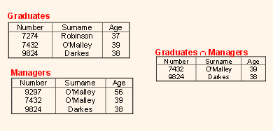
Example

Slide 33
